Slide 1
Defensive Driving

Slide 2
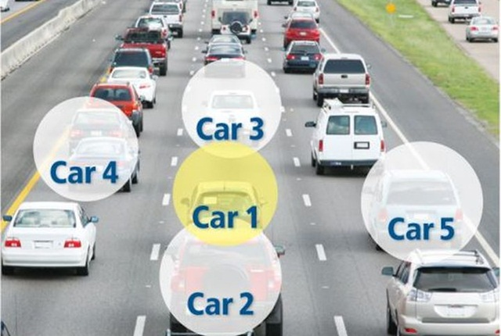
Defensive Driving

Slide 3
Signal what you plan to do!

Slide 4
Use your mirrors.

Slide 5
Keep to the speed limit, especially to 50 kmh (km per hour) in town.

Slide 6
Keep your distance from the car in front.
Your SPEED | Your DISTANCE
30 kmh | 15 meter
50 kmh | 25 meter
70 kmh | 50 meter
90 kmh | 75 meter
120 kmh | 100 meter

Slide 7
Mind pedestrians, cyclists and animals along the road

Slide 8
Give way to ambulance, fire engines or police when their blue lights flash or two-tone horns sound.

Slide 9
Respect alcohol or medicine limits.

